Slide 1
Recalculate button hidden for ‘no cover selected’
Test brief and MAC doc

Slide 2
Hypothesis
Currently the recalculate button is not smart enough to appear for only new selections i.e. when a user first lands on the quote page and clicks ‘no cover required’ on the add-on table, the recalculate button appears even though there is nothing to recalculate. Also, if a users toggles through NCD protection and/or Voluntary Excess settings, the recalculate button is always shown even if the selected options do not affect the price. Essentially, you should only see the recalculate button when there’s actually something to recalculate. We believe that by only showing the recalculate button when it is necessary, we will reduce fall-out on the quote page and the breakdown page, particularly for mobiles.
Settings:
This test will run across all devices on either esure or Sheilas’ Wheels, depending on which journey is available for testing once this test gets signed off.
KPI: click-throughs to the breakdown step and click-throughs to the quote summary step
Test pages: motor quote page and breakdown page

Slide 3
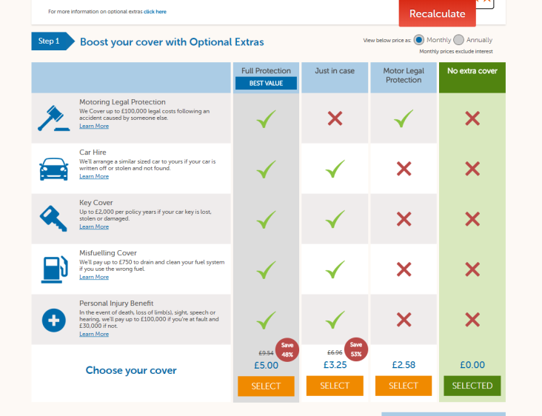
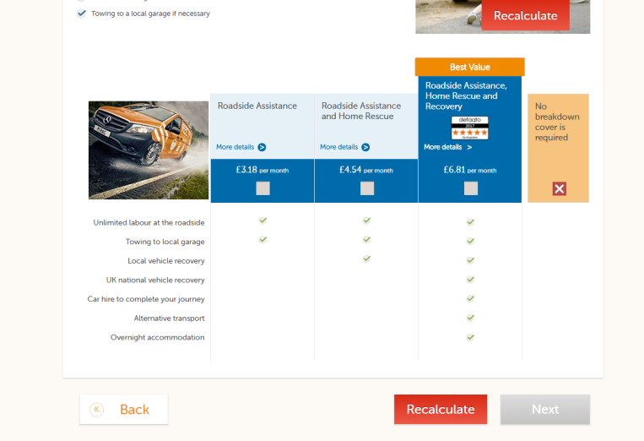
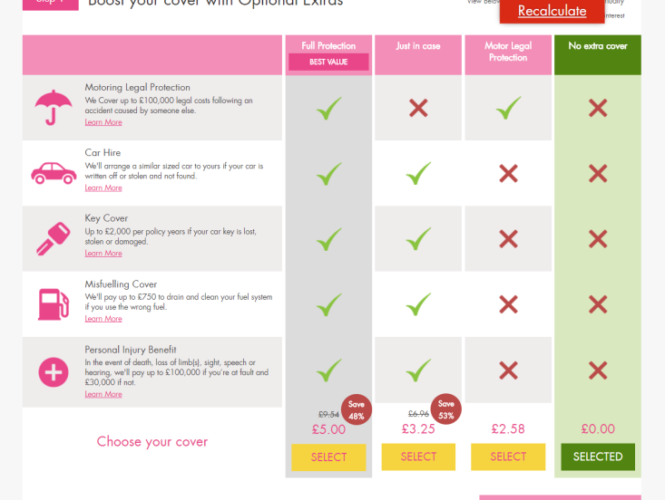
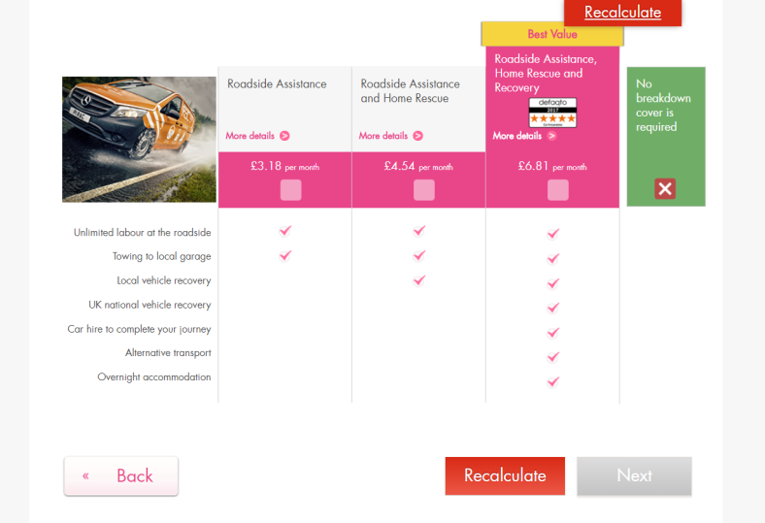
Current functionality
Quote page add-ons
Breakdown page
This user has selected ‘no cover required’. As these selections do not impact the current quote price, the recalculate button should not be shown. The only time ‘recalculate’ should be shown is when the current selection adds/or removes a feature that will affect the current calculated price.

Slide 4
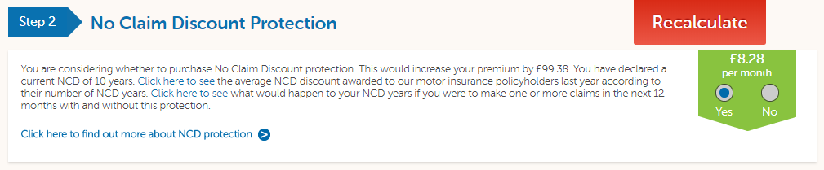
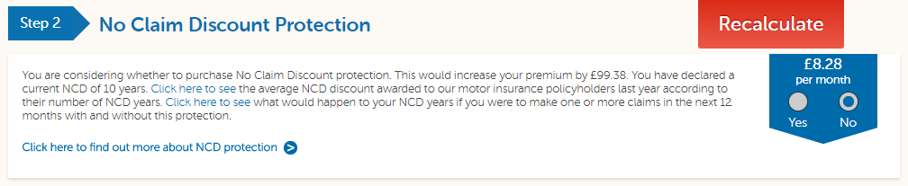
Current Functionality
1) User selects NCD protection – Recalculate appears
2) User de-selects NCD protection before recalculating – Recalculate is incorrectly still showing as the setting has been returned to the previously-calculated setting
Note: the same thing happens on Sheilas’ Wheels

Slide 5
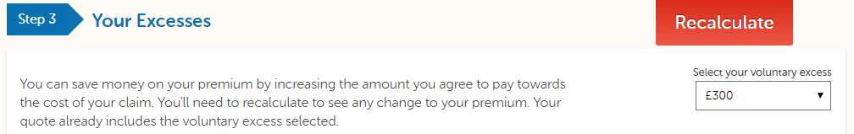
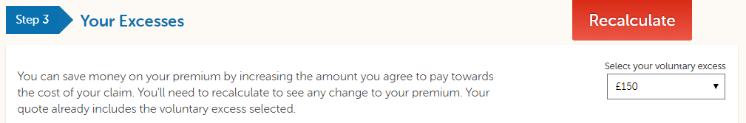
Current Functionality
1) User adds additional voluntary excess – Recalculate appears
2) User sets voluntary excess back to the default setting before recalculating – Recalculate is incorrectly still showing as the setting has been returned to the previously-calculated setting
Note: the same thing happens on Sheilas’ Wheels

Slide 6
Technical considerations
Simply hiding the button on-click will not be sufficient as there are multiple scenarios where a user may still need to recalculate. Logic will have to be created in order to cater for the following:
Toggling between cover – pre-recalculation: when a user first lands on the page, i.e. before any recalculation has occurred, the user may select ‘no cover required’ in the add-on table or breakdown table and the button should therefore be hidden. But if they then select some cover from the table, the recalculate button should appear as the new selection will alter the price. However, if they toggle back to ‘no cover’ before recalculating, the button should disappear again as a ‘no cover required’ selection will not alter the price
Toggling between cover – post-recalculation: if the user has already performed a recalculation, the logic should understand what is the current selection i.e. if the user has recalculated after selecting some cover, only selections that differ to the current selection should trigger the recalculate button
NCD Protection and Voluntary Excesses: the user’s add-on selection has resulted in the button being hidden i.e. they haven’t changed anything since the last recalculation. However, if they then add NCD protection and/or change their excesses, the recalculate button should re-appear. Both the NCD protection and voluntary excess amount have an impact on the quote price. However, if they toggle back to their previous settings before clicking recalculate, the button should disappear. Only a selection that differs from the currently calculated selections should trigger the recalculate button
Current selection logic: all the above scenarios assume that logic can be built to differentiate between selections that alter the current price and selections that don’t alter the current price
Background recalculations and the ‘Next’ button: Even though Optimizely should be able to mimic this functionality, our site’s back-end cannot be edited. Therefore, even when Optimizely has hidden the recalculate button, an unnecessary recalculation, i.e. a recalculation where no price change will occur, will still need to happen. So, when recalculate is hidden the ‘Next’ button should be visible and clickable and should also trigger any left-over unnecessary recalculations. These should happen in the on-click of the ‘Next’ button. To ensure minimal flicker, the page should be blanked out as any further recalculations occur and only the loading-gif-page should be shown

